Slide 1
Submission of the One-time (special) voluntary declaration

Slide 2
STEP 1: User's E-identification online using a qualified electronic signature of any accredited key certification authority – qualified provider of electronic trust services.
STEP 2: Choose the «One-time (special) voluntary declaration» in the private part of «E-cabinet for citizens» and click Create.

Slide 3
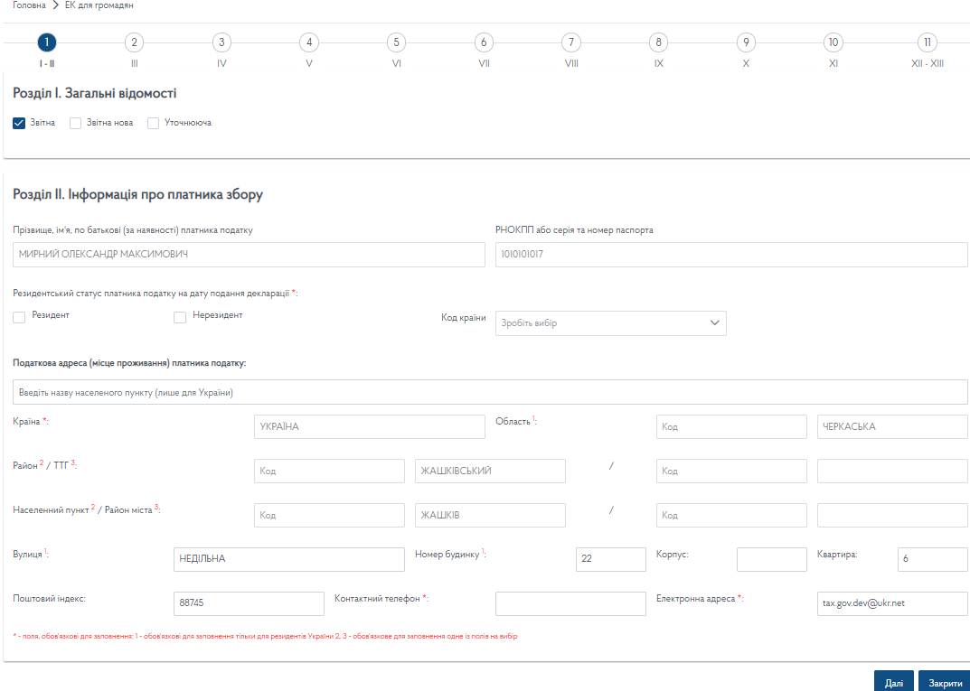
STEP 3: Choose required section in the screen form of Declaration.
Go to required section at the top of active window.

Slide 4
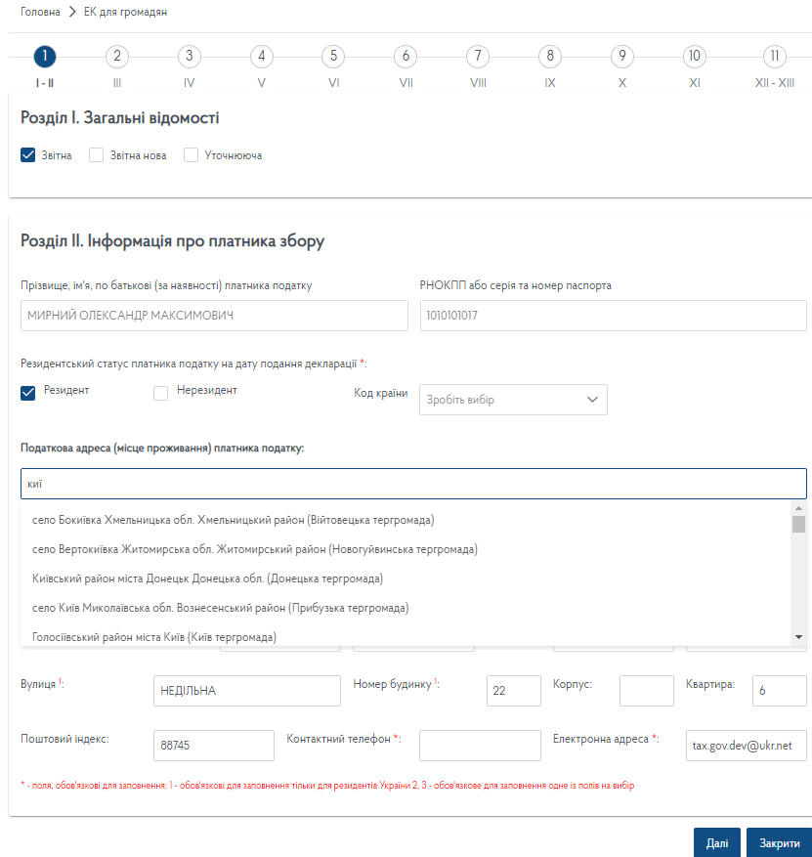
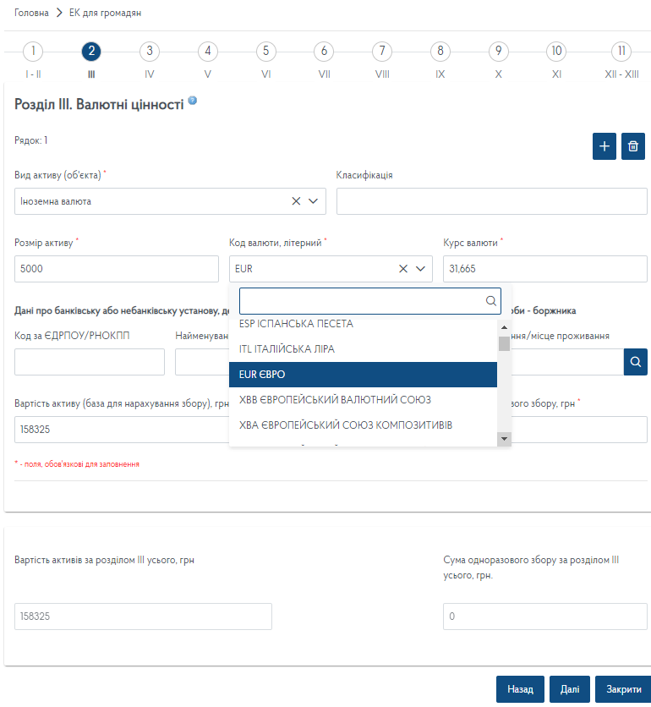
STEP 4: Fill in sections of the Declaration
STEP 4.1: Enter the first three letters of the name (title) to get a choice in the list of settlements.
STEP 4.2: Select the type of currency from the suggested directory. The exchange rate is filled in automatically on the date of filling in the Declaration.
Transition between sections is done using "Next" and "Back"

Slide 5
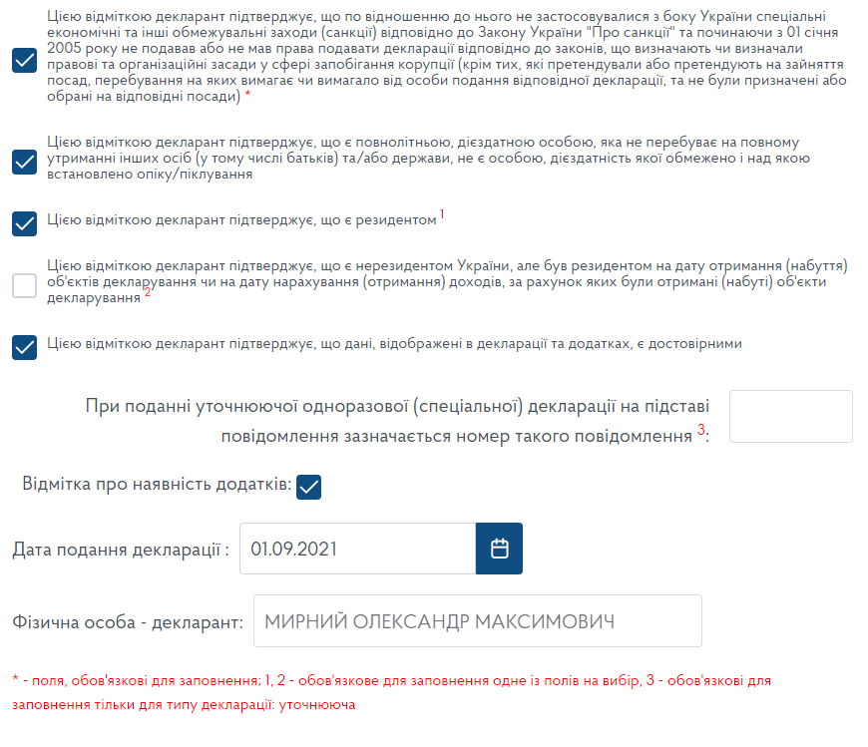
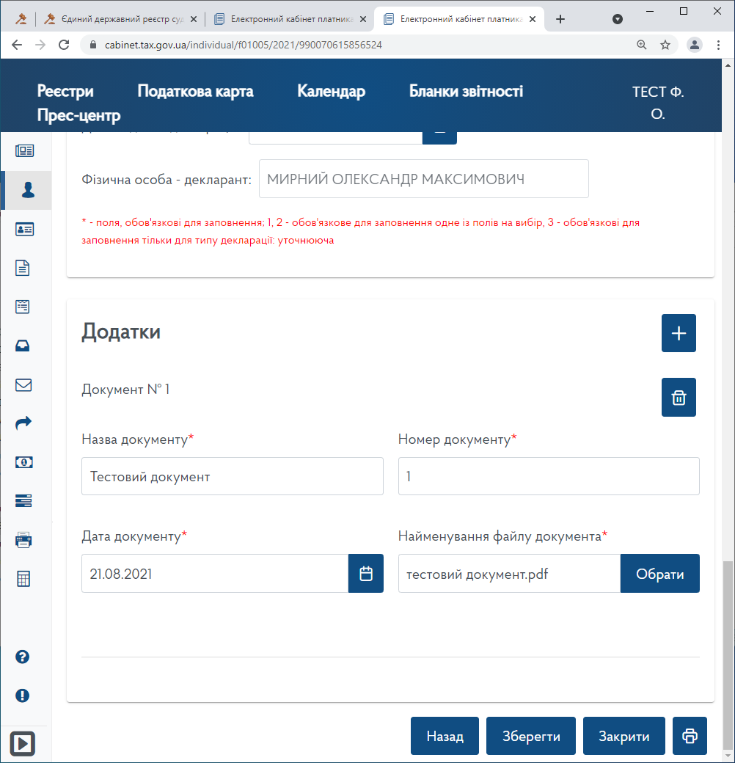
STEP 5: Put mandatory marks and mark on the availability of annexes.
STEP 6: Attach scanned copies of the required documents by clicking in section ANNEXES.
Click Save after successful filling in of all required sections of the Declaration..
Press to download and print the Declaration.

Slide 6
STEP 7: Sign the Declaration using a qualified electronic signature.
STEP 8: Send signed Declaration.
Buttons «Sing» and «Send» become active after selection of required Declaration in the provided list.

